Slide 1

GEEKS FOR GEEKS SOLVING FOR INDIA HACKATHON
TOPIC:
SPORTS AND FITNESS

Slide 2
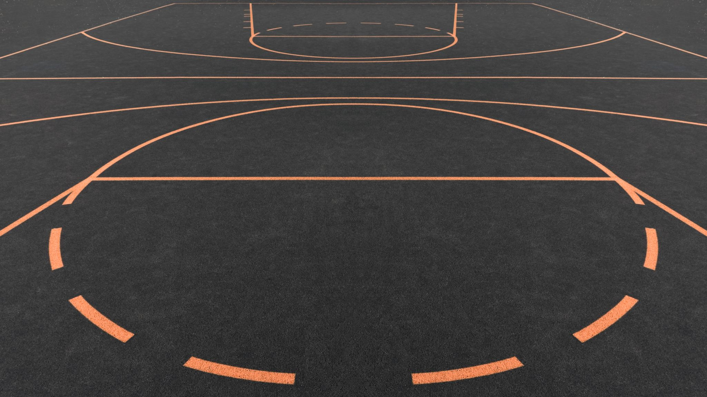
SPORTS VILLA

Slide 3
OBJECTIVE
The project is all about an application connecting people with a common interest in sports.
In this application, users can chat with others who are also interested in the same sport. Not only connecting with the individuals but this app allows users to join communities and create communities which allow the users to connect socially.
Furthermore, there are many features like a listing of rules and regulations of the game, training sessions for users in the field they desire that enhances their game skills, medical help for common injuries in the game , list of core workouts specially for the particular field in the sport.

Slide 4
USER DETAILS
The user must provide his mail address and a username.
Each user is identified only with a unique User ID which is associated with the user's mail address.
User is given access to write something about himself in the Bio section.
User can also upload a profile picture, his sports achievements and awards that would be displayed in his account details.

Slide 5
List of sports :
BASKETBALL
VOLLEYBALL
CRICKET

Slide 6
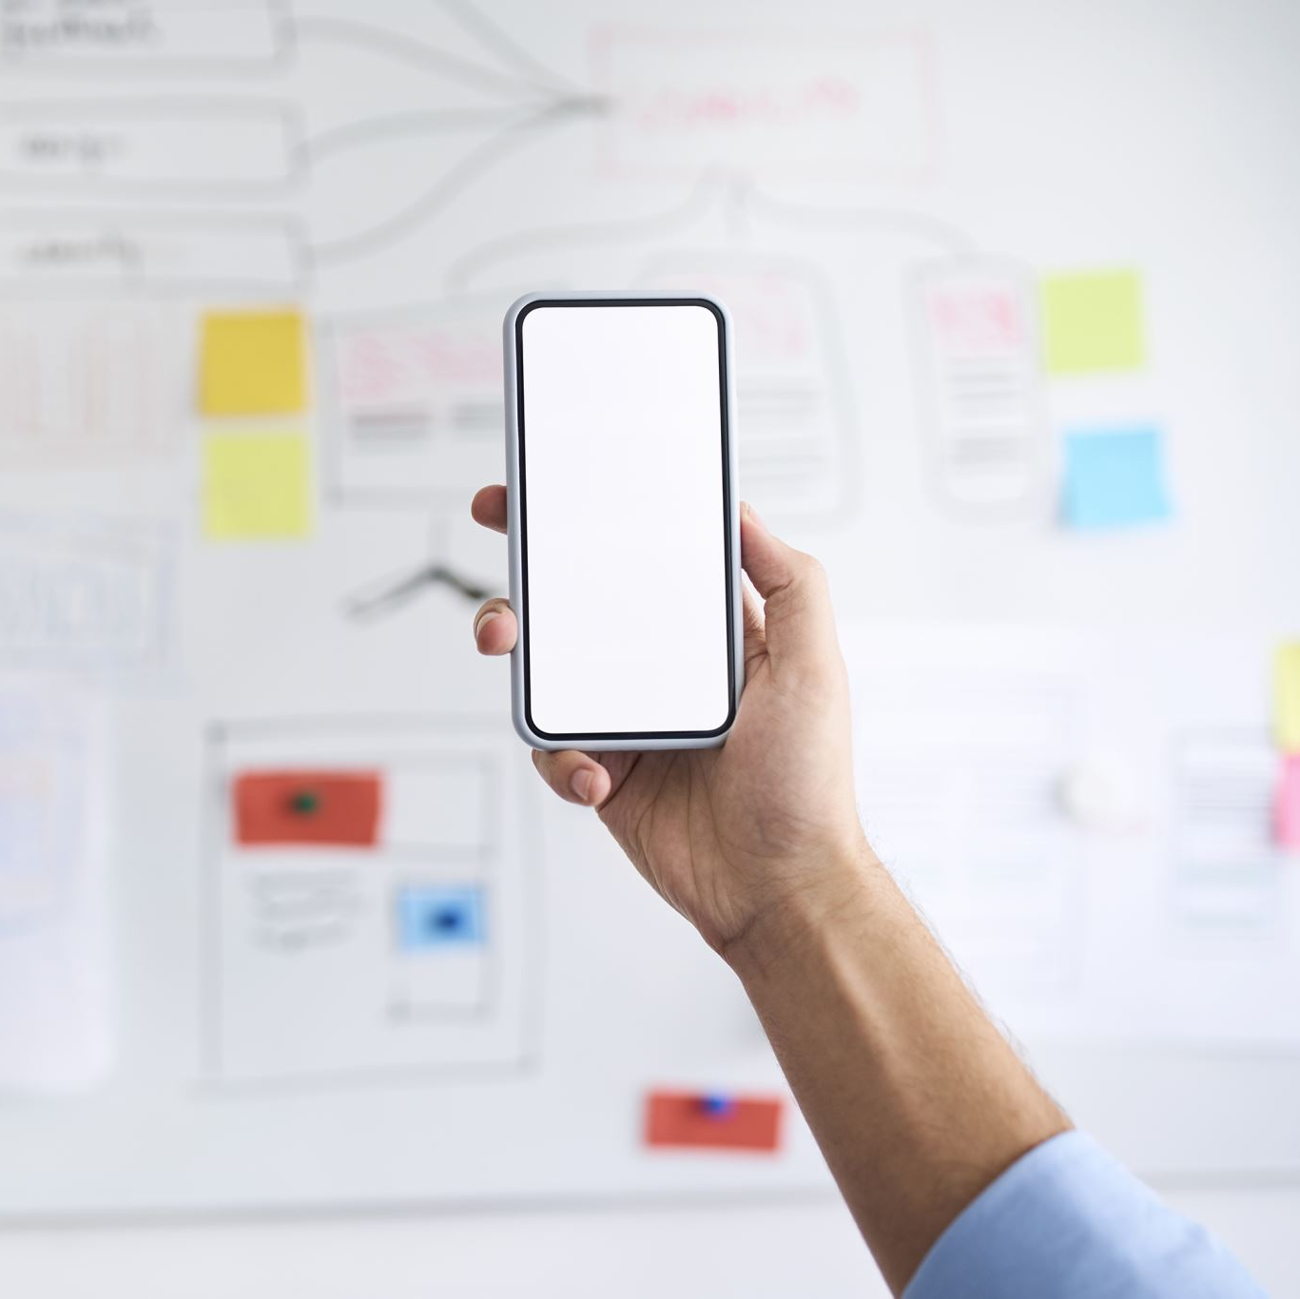
INTERFACE
A few of the user interfaces (Mobile Interfaces) are shown in this presentation like the login page , the main page of the application followed by the account pop up on the main page.

Slide 7
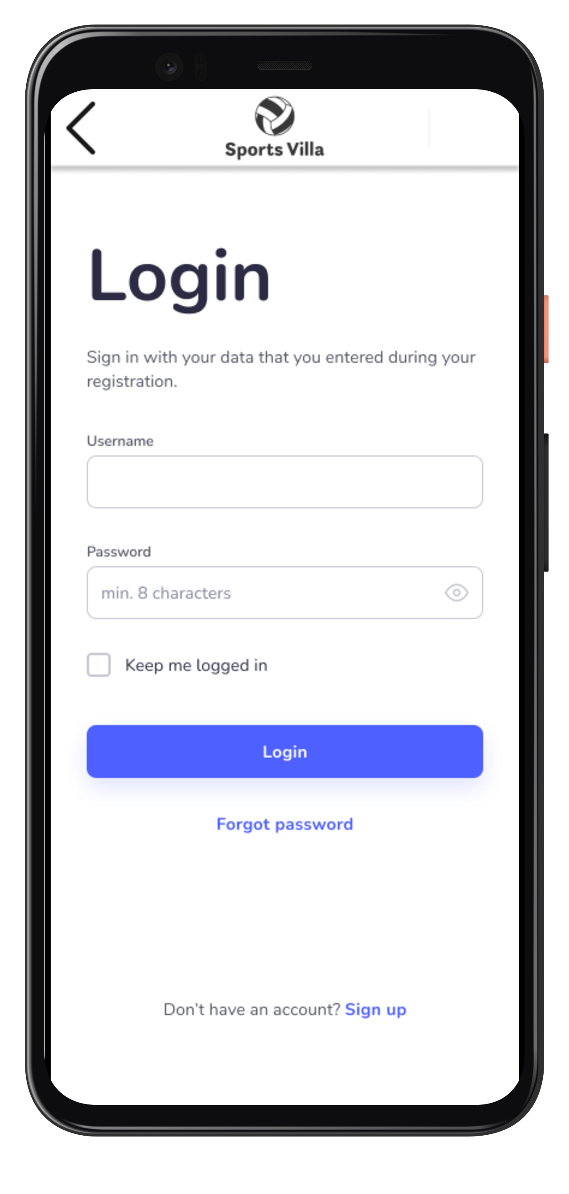
LOGIN PAGE
This is the first page of the application where the user has to sign up with his mail account and set a password for himself.
Once the user has signed up he can again log in and log out by giving his registered mail account.
Users also have a facility to access their account in case of forgetting their password. This is done by generating an OTP and sending it to the registered mail , by entering this OTP the user must change their password to ensure security of the account.

Slide 8
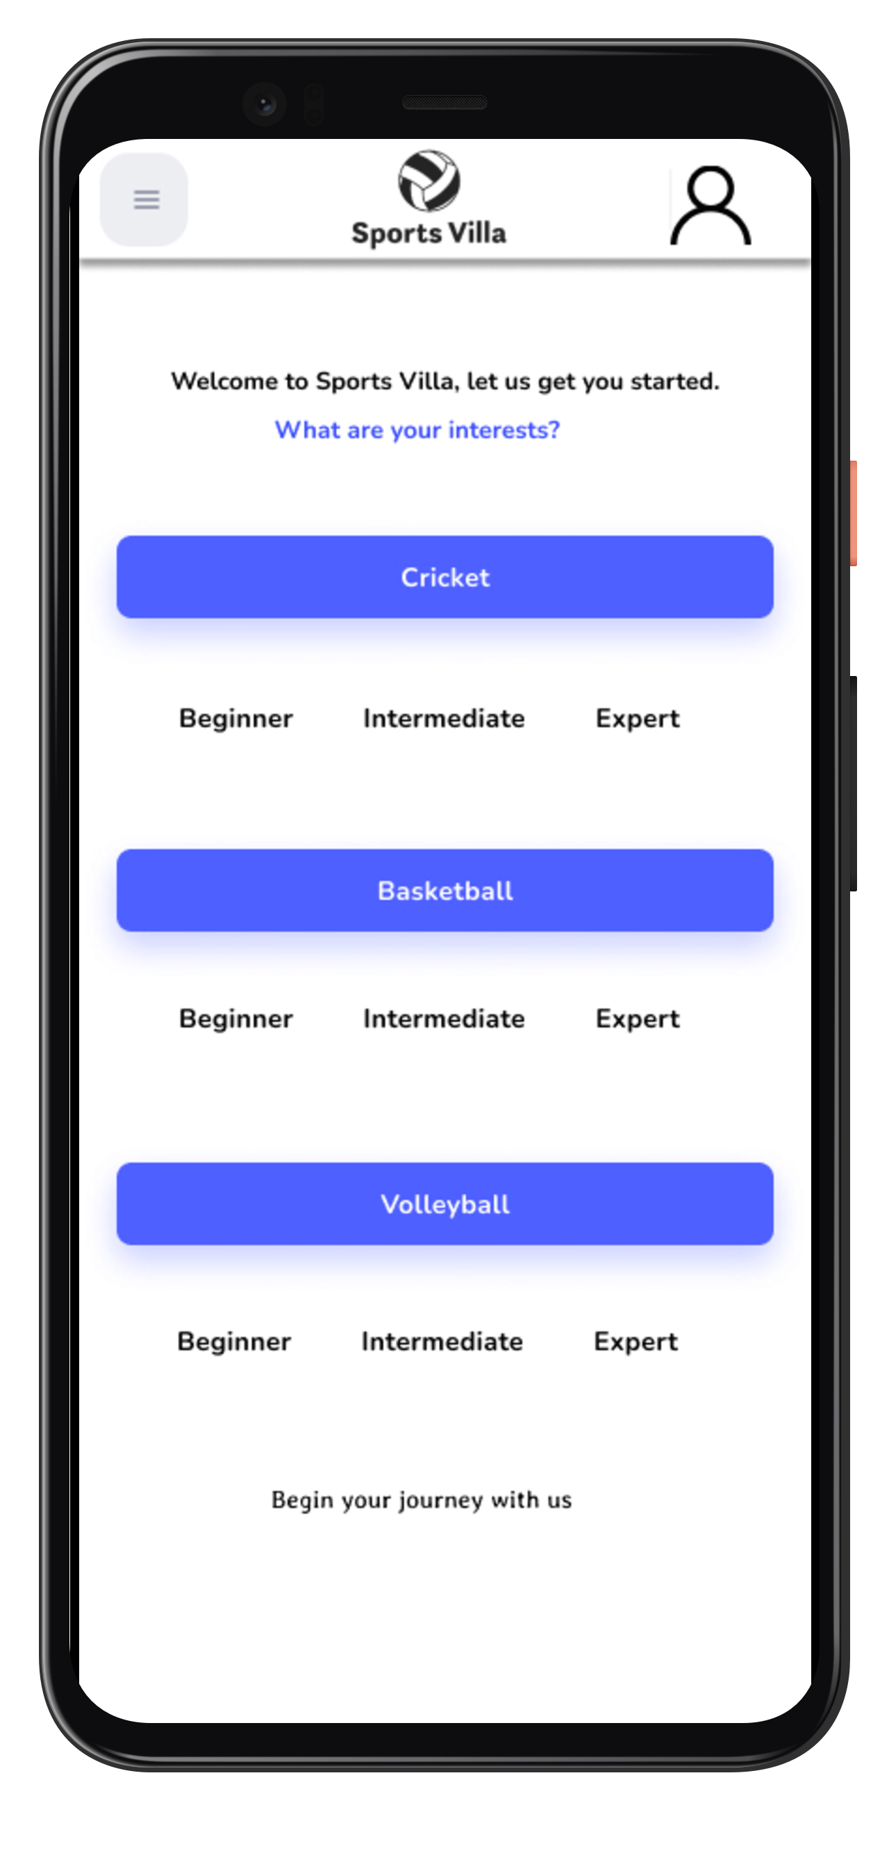
MAIN PAGE
After the user logins into the application, the main page appears.
Here user can choose any one of the sports he is interested in, further, there would be 3 options under a sport in order to make the user meet people within the same level of the game.
Although communities are the same and people can chat with any level player users are separated by their levels.
The reason behind this is, to make the user know more about the game from starting if the user is a beginner, to start game training if the user is intermediate, and to guide others if the user is an expert.

Slide 9
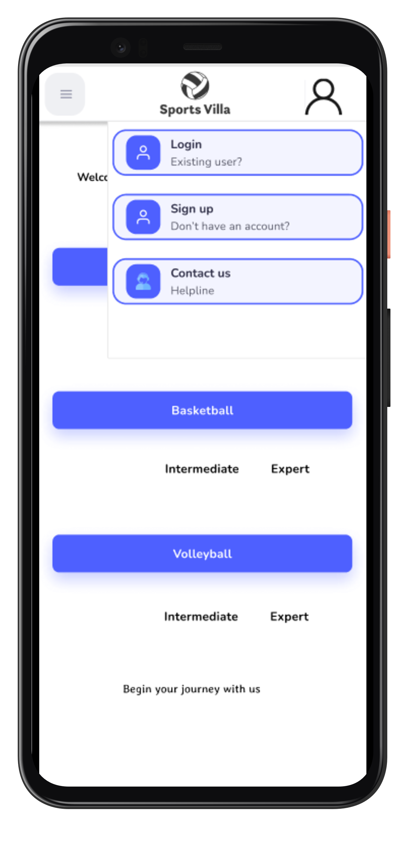
ACCOUNT AND HELP PAGE
User can access their account by clicking on the top right symbol where they can change their account or can contact the customer support team to resolve any type of issue.
Not only resolving any issue , user can also provide a suggestion or a feedback on the application directly to the team.
The 3 small lines at the top left redirect the user to the settings of the application , privacy policy of the application , and help desk.

Slide 10
BASKETBALL PAGE
Consider the user selects basketball as his sport , they can now access their previous chats or can start new chats and communities by clicking the icons at the bottom.
There are 3 different modes on the page, those are chats section , game training , and the medical support section.
The game training section involves all types of workouts, strategies, and training sessions of different fields in the game.
The medical section involves medication for general types of medications caused by some common injuries during the gameplay.

Slide 11
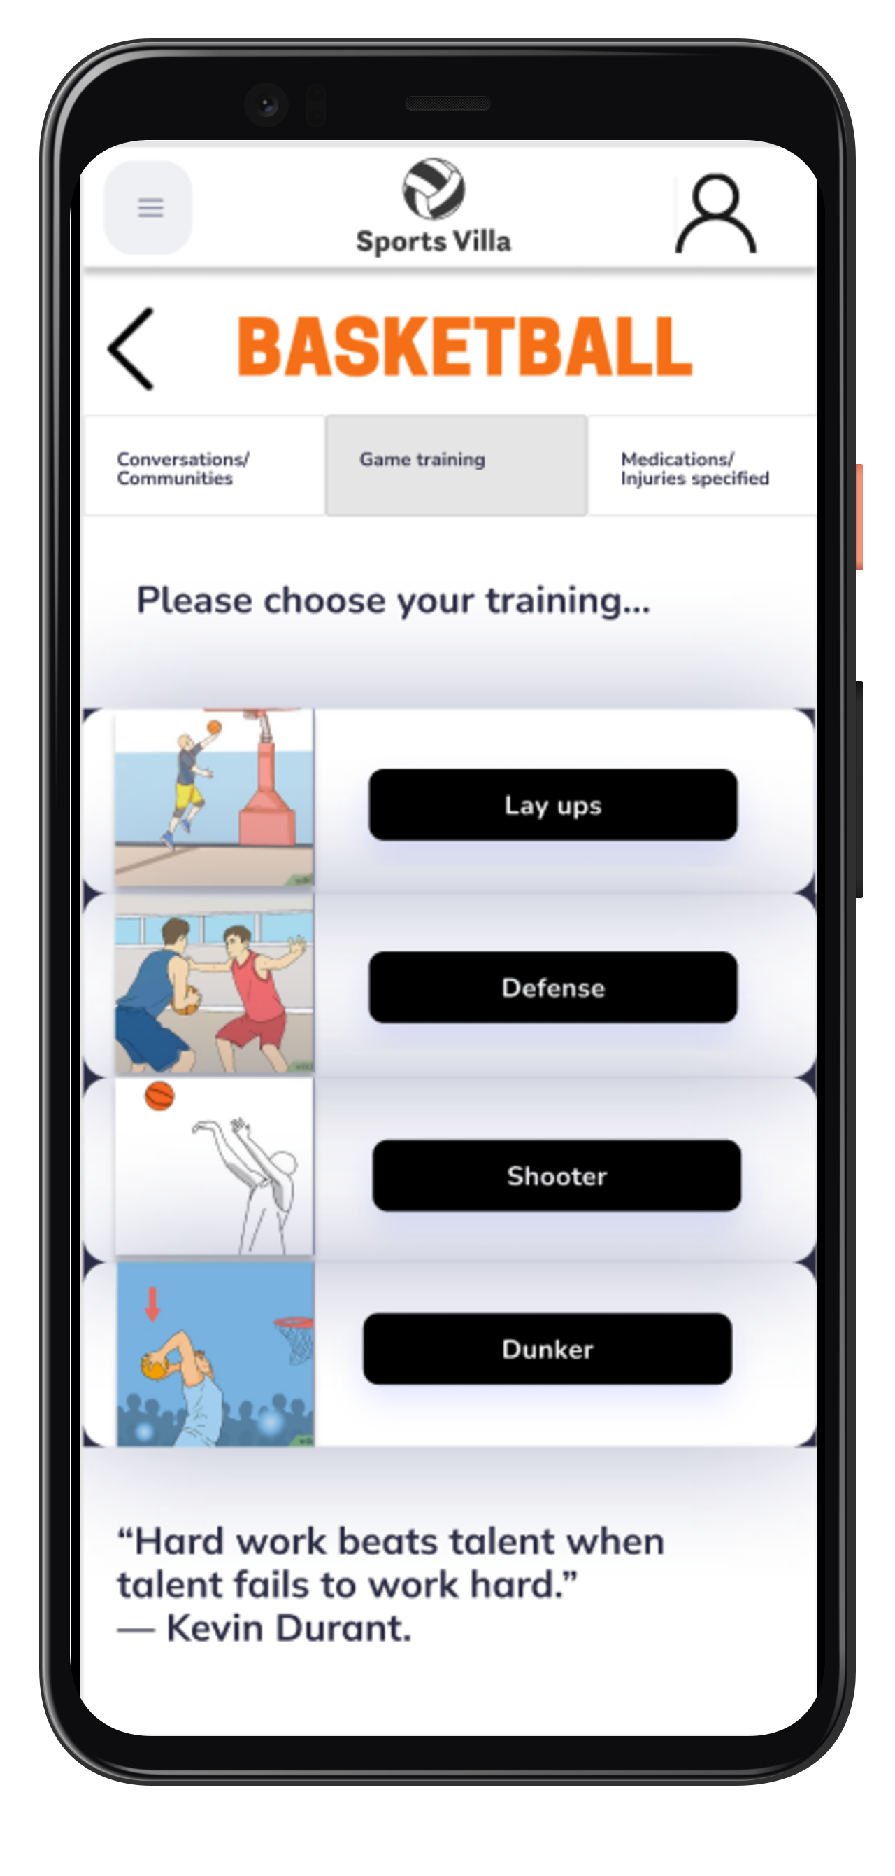
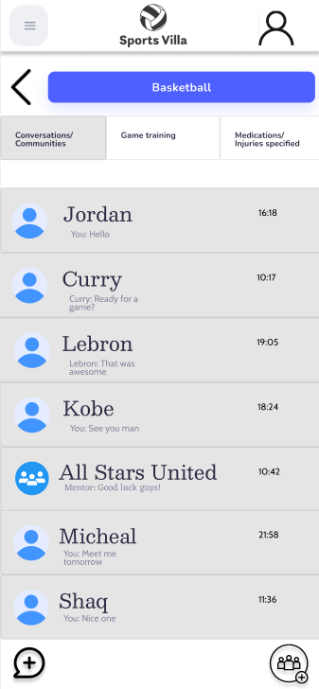

Slide 12
Similarly, we can access all the other sports mentioned on the main page of the application with the same features .
Users can access all sports but not at a time, when the user want to change the sport they must click on the arrow icon (shown in previous slide) at the top and select the other sport.
Rules and regulations of each sport can be accessed by clicking on the sport name which is at the top.
Chats and communities will not coincide from one sport section to the other.
This application makes all sports lovers meet on a perfect platform and also get trained by mentors.

Slide 13
THANK YOU
DONE BY :
RISHI SAI TEJA RAMANCHI
ABHINAY SRIKANTH KHAMITHKAR
AJITH KUMAR MYKALA

